Slide 1
上週未處理完成部分

Slide 2

from 9 Dec
Award
Webpage:
https://kwh.9u1.net/Awards.html
Google Drive:
https://docs.google.com/document/d/1r65N5h3MqDEO9lqBSnHRxwMMHy8oK97U/edit?usp=drive_link&ouid=111471142683719346953&rtpof=true&sd=true
回覆: 使用原設設計
把第一張圖片作封面圖片

Slide 3

https://kwh.9u1.net/history.html
from 16 Dec
與PPT後面重疊, 現前按後面的指示作準
In April-July2023 更改為All services were relocated into the Phase 1 Building in phases during April to July 2023
In 31 July 2023 更改為The East Wing, North Wing, TWGHs Yu Chun Keung Memorial Centre and Staff Barracks were handed over to the main contractor in late July 2023

Slide 4
https://kwh.9u1.net/Services/Paediatrics-And-Adolescent-Medicine.html
from 16 Dec
已完成
內容尚未更改
https://docs.google.com/presentation/d/1WSmWljZu6YRlJKnW7oldqUm-0ssXW-H9/edit
第5, 6, 8, 10, 11, 12, 14, 15, 16頁

Slide 5
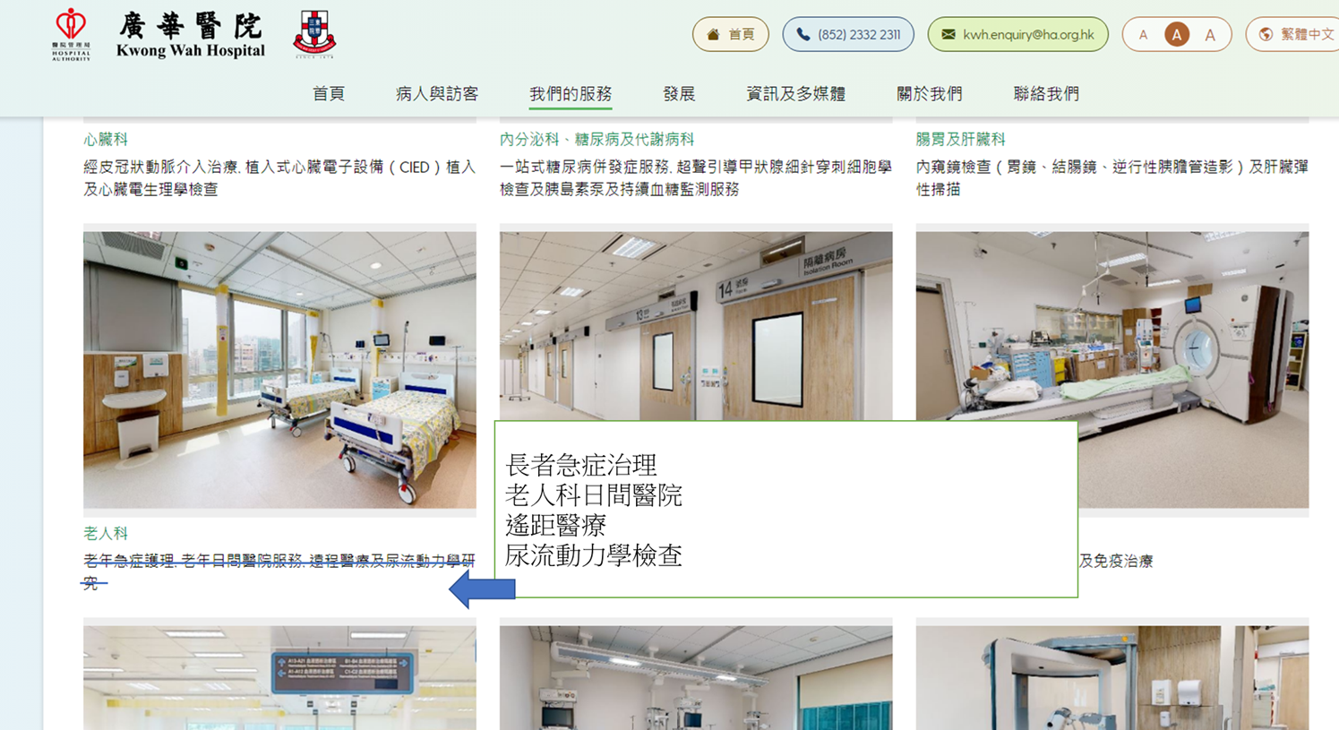
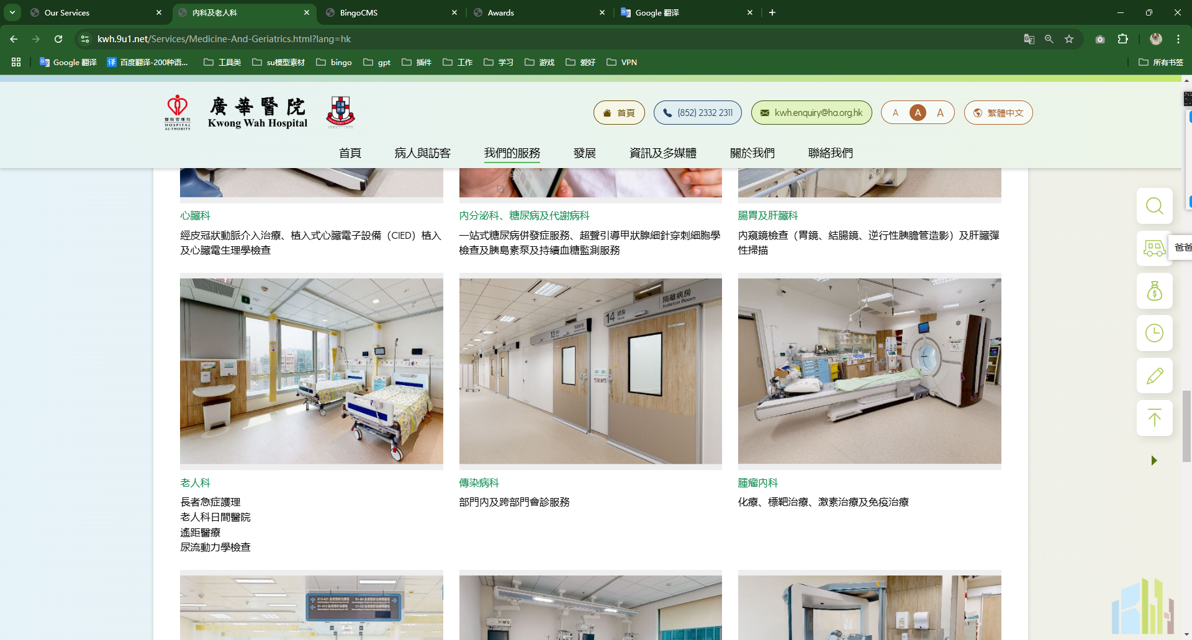
https://kwh.9u1.net/Services/Medicine-And-Geriatrics.html
from 16 Dec
標示已修改但未修改
沒有發現錯處
繁體中文尚未更改

Slide 6
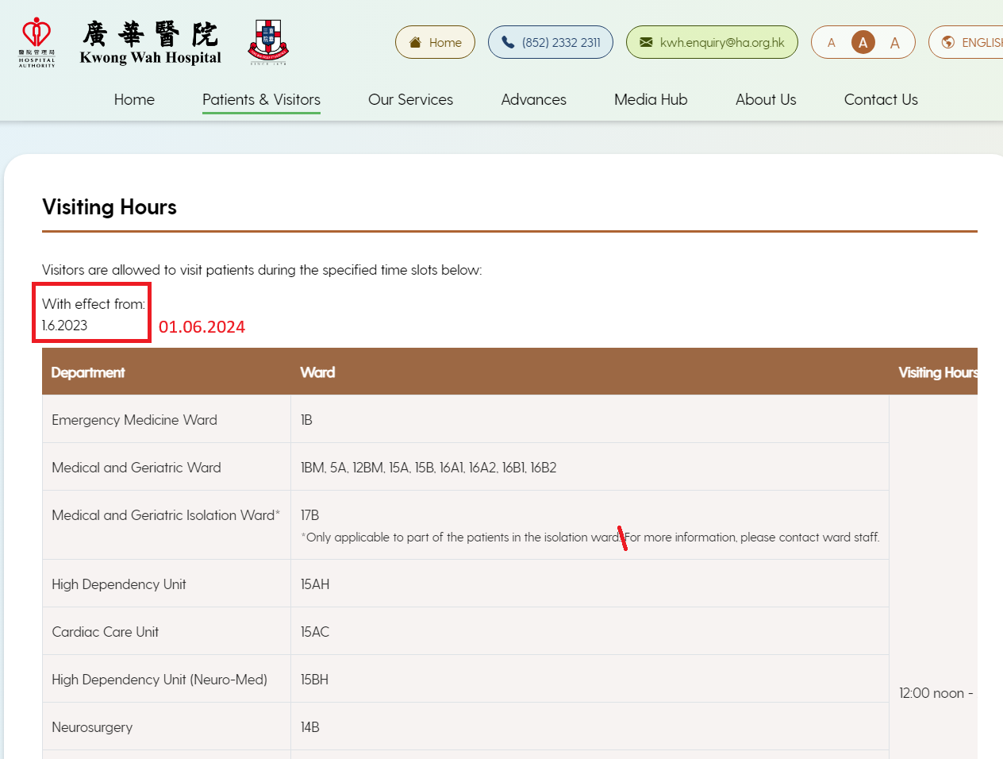
https://kwh.9u1.net/Visitors.html
from 17 Dec
已完成
沒有根據文檔更新日子更改
生效日期
*所有語言版本*

Slide 7
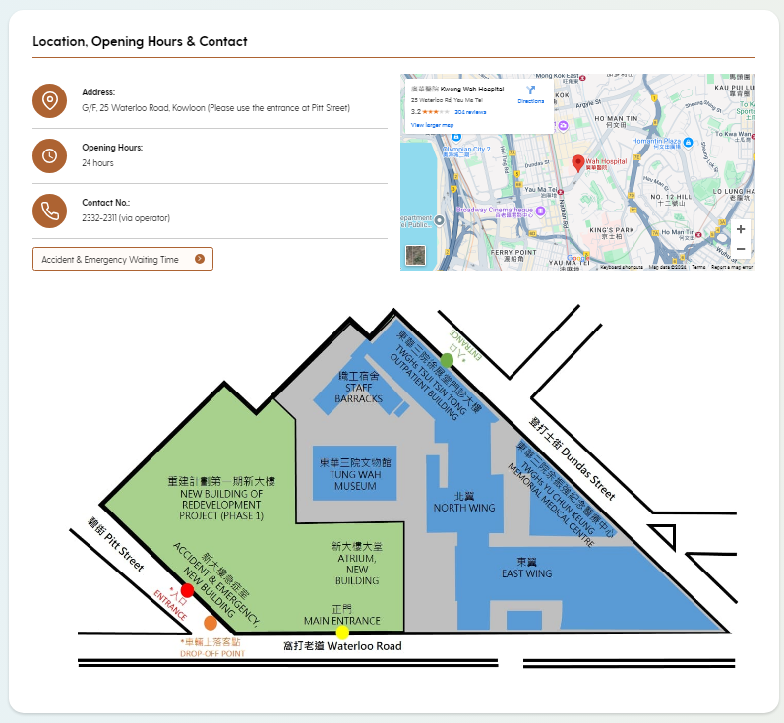
https://kwh.9u1.net/Emergency.html
from 18 Dec
沒有發現錯處
請根據語言更換地圖
Google Drive:
https://drive.google.com/drive/folders/1BZp52dBncovH5fBwefawCwBFcMJiiB8i?usp=drive_link

Slide 8

https://kwh.9u1.net/Services/Health-Promotion-Centre.html
from 19 Dec
已完成
中文版更正: 社區協作及建立夥伴關係
英文版更正
For enquiries, please contact our Health Promotion Centre at 3517 4677.
Facilitate patient support groups in organizing activities so as to establish a mutual support network among themselves.
Organize health-related programmes to enhance patients and carers’ quality of life

Slide 9
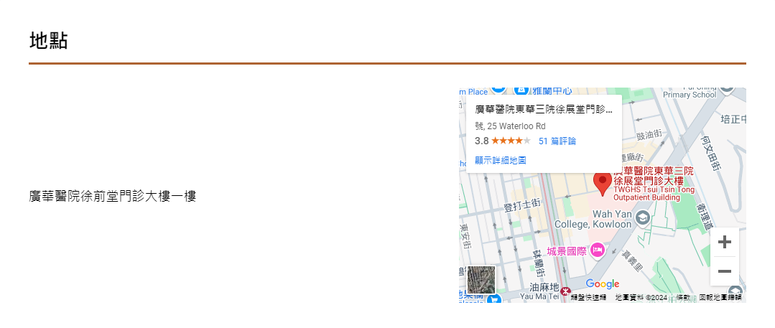
https://kwh.9u1.net/General-Out-patient.html
from 23 Dec
已完成
熱帶氣旋警告/ 「極端狀況」及暴雨警告的特別安排
Special Arrangement for Tropical Cyclone Warning / “Extreme Condition” and Rainstorm Warning
移動至「地點」下方
「廣華醫院徐前堂門診大樓一樓」
更改為
「東華三院徐展堂門診大樓1樓 (登打士街入口)」
英文是: 1st Floor, TWGHs Tsui Tsin Tong Outpatient Building (Dundas Street Entrance)

Slide 10
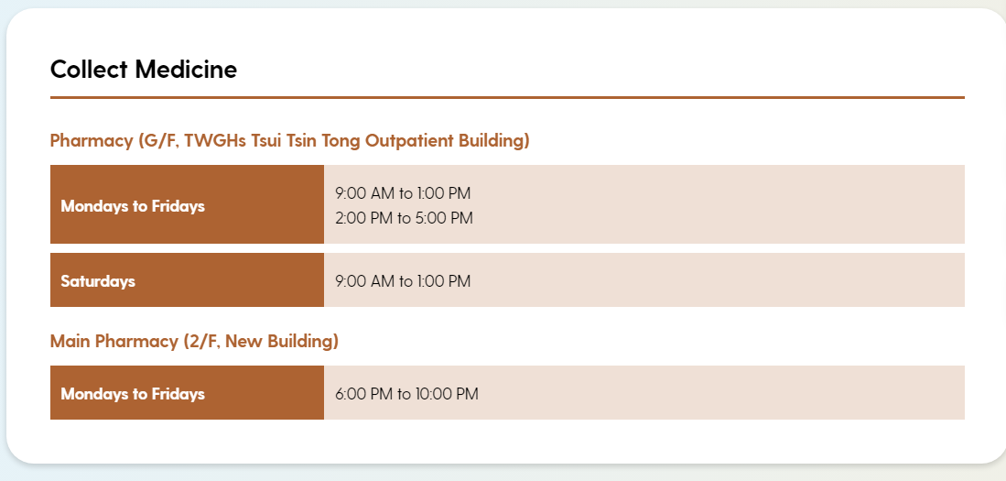

https://kwh.9u1.net/General-Out-patient.html
from 23 Dec
待檢查
Pharmacy (G/F, TWGHs Tsui Tsin Tong Outpatient Building) 更改為 “Outpatient Pharmacy, G/F TWGHs Tsui Tsin Tong”
Main Pharmacy (2/F, New Building) 更改為
“Outpatient Building (for AM and PM session patient)
(2F Main Building for Evening Clinic patient)”
門診藥劑部（東華三院徐展堂門診大樓地下）
更改為「東華三院徐展堂門診大樓地下門診藥劑部」

Slide 11
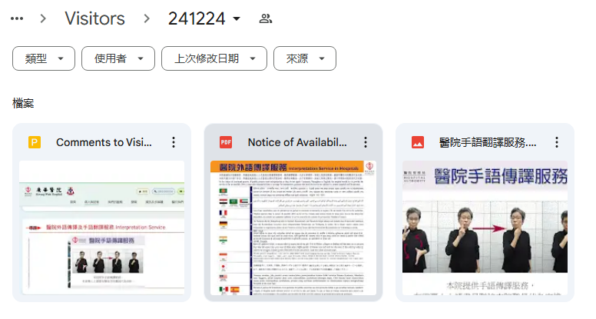
https://kwh.9u1.net/Visitors.html
已修改
https://drive.google.com/drive/u/1/folders/1zPditDSbk2SeYeIdsbIEBVUg5Ni47emQ

Slide 12
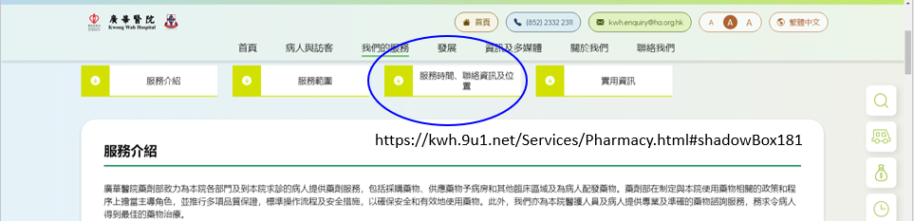
Redirect link to Pharmarcy>Service Hours, Contact Information and Location for the following 4 locations: https://kwh.9u1.net/Emergency.html
https://kwh.9u1.net/In-patients.html
https://kwh.9u1.net/Specialist-Out-patient.html
https://kwh.9u1.net/General-Out-patient.html
待檢查

Slide 13
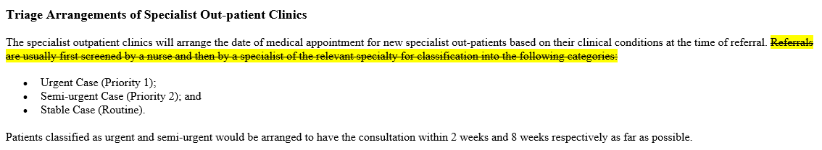
For SOPD
https://kwh.9u1.net/Specialist-Out-patient.html
與PPT後面重疊, 現前按後面的指示作準
已完成
Please amend (Chinese & English version )

Slide 14
https://kwh.9u1.net/Services/Pharmacy.html
from 23 Dec
已完成
在Pharmacy Services藥劑服務 和Useful Information實用資訊
連結錯誤
繁體中文版:
「覆配易」覆配藥物服務https://www.ha.org.hk/visitor/template27.asp?Parent_ID=10081&Content_ID=241420&Dimension=100&Lang=CHIB5&Ver=HTML&Change_Page=1
簡體中文版:
「覆配易」覆配药物服务
https://www.ha.org.hk/visitor/ha_view_content.asp?Content_ID=241423&Lang=CHIGB&Dimension=100&Parent_ID=10081

Slide 15
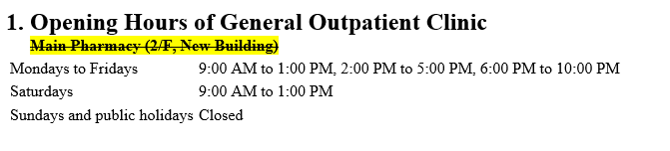
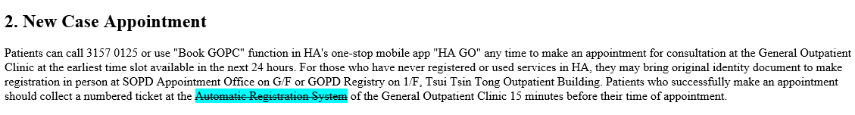
For GOPD
https://kwh.9u1.net/General-Out-patient.html?lang=en
from 23 Dec 2024
沒有發現錯處
One-Stop Electronic Kiosk

Slide 16
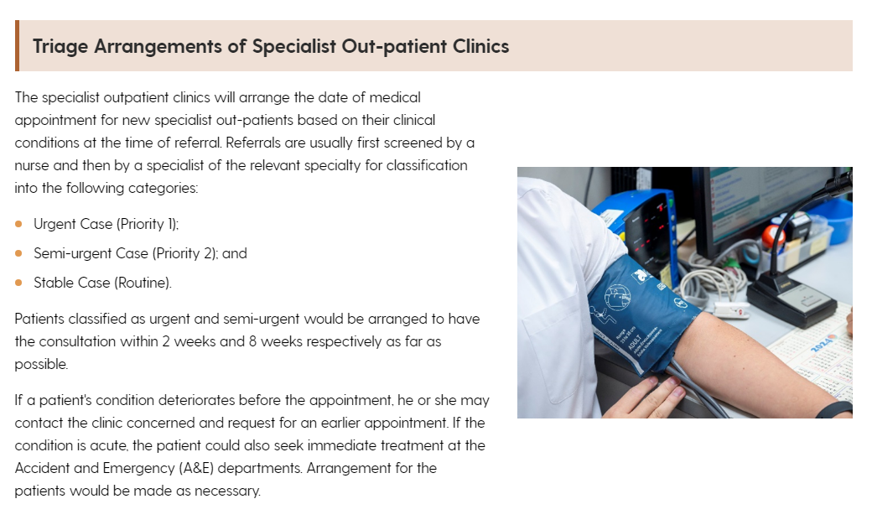
https://kwh.9u1.net/Specialist-Out-patient.html
from 23 Dec
已完成
The specialist outpatient clinics will arrange the date of medical appointment for new specialist out-patients based on their clinical conditions at the time of referral. Referrals will be screened by a specialist of the relevant specialty for classification into the following categories:
Urgent Case (Priority 1);
Semi-urgent Case (Priority 2);
Stable Case (Routine)
Patients classified as urgent and semi-urgent would be arranged to have the consultation within 2 weeks and 8 weeks respectively as far as possible.
If a patient's condition deteriorates before the appointment, he or she may contact the clinic concerned and request for an earlier appointment. If the condition is acute, the patient could also seek immediate treatment at the Accident and Emergency (A&E) departments.

Slide 17
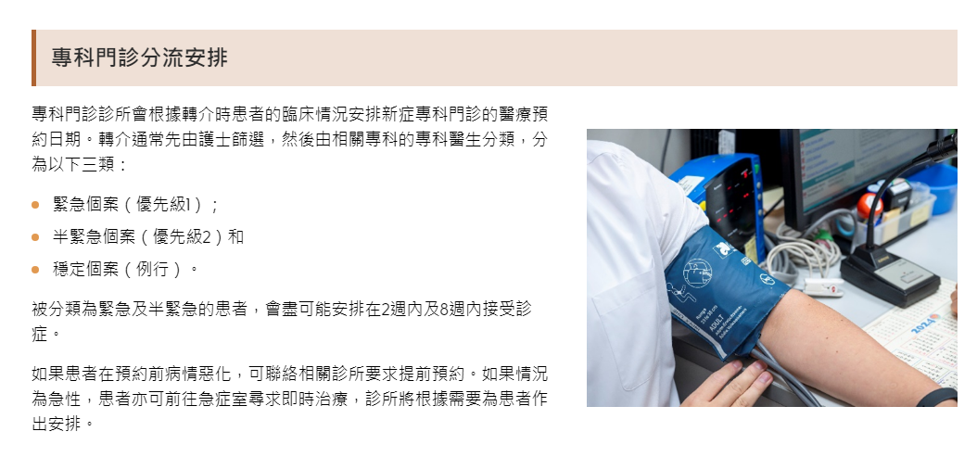
https://kwh.9u1.net/Specialist-Out-patient.html
from 23 Dec
已完成
專科門診診所會根據轉介時患者的臨床情況安排新症專科門診的醫療預約日期。轉介通常先由護士篩選，然後由相關專科的專科醫生分類，分為以下三類：
醫護人員會因應病人的臨床情況，決定病人在專科門診就診的先後緩急。新症轉介個案會由專科醫生檢視病人的轉介信及檢查報告，按照臨床情況，把病人列入以下分流類別︰
緊急(第一優先類別)個案；
半緊急(第二優先類別)個案；
穩定(例行類別)個案
被列為緊急及半緊急的病人，醫護人員會盡量安排他們於兩星期及八星期內就診。
若病人的狀況在輪候期間出現惡化，病人可聯絡有關的專科門診診所，要求提早約見醫生，若病情緊急，病人亦可到急症室求診。

Slide 18
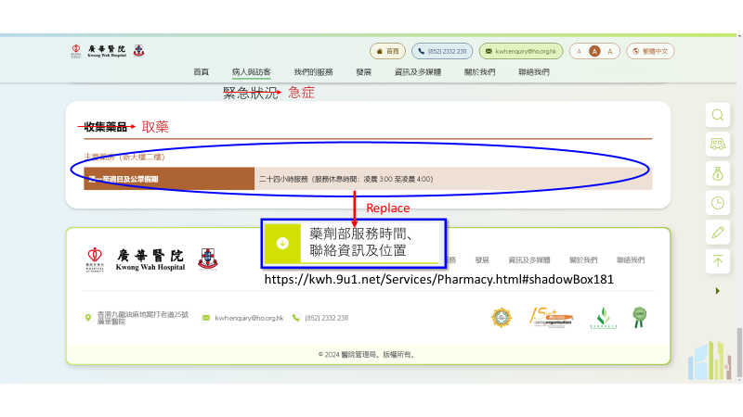
https://kwh.9u1.net/Emergency.html
from 31 Dec
待檢查
Rename to 急症
Redirect link to Pharmarcy>Service Hours, Contact Information and Location

Slide 19
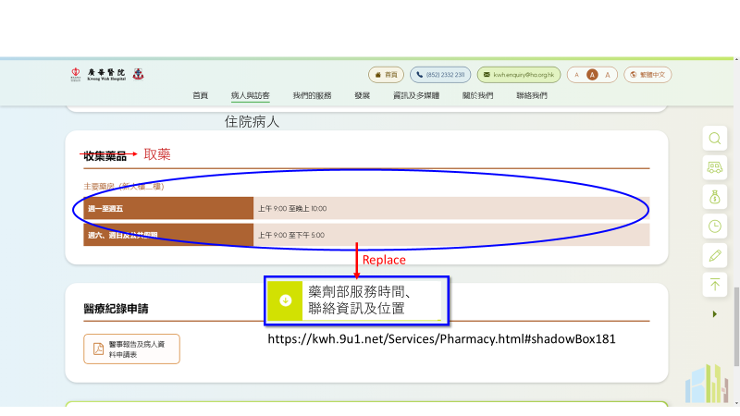
https://kwh.9u1.net/In-patients.html
from 31 Dec
待檢查
Redirect link to Pharmarcy>Service Hours, Contact Information and Location

Slide 20
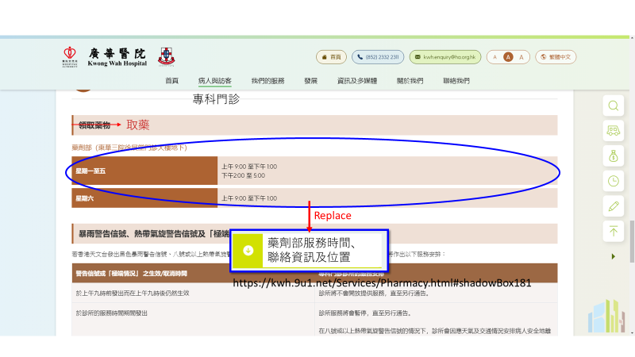
https://kwh.9u1.net/Specialist-Out-patient.html
from 31 Dec
待檢查
Redirect link to Pharmarcy>Service Hours, Contact Information and Location

Slide 21
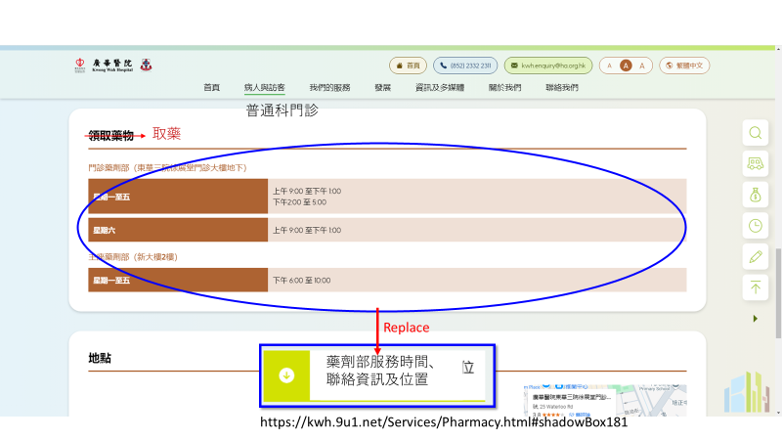
https://kwh.9u1.net/General-Out-patient.html
from 31 Dec
待檢查
Redirect link to Pharmarcy>Service Hours, Contact Information and Location

Slide 22
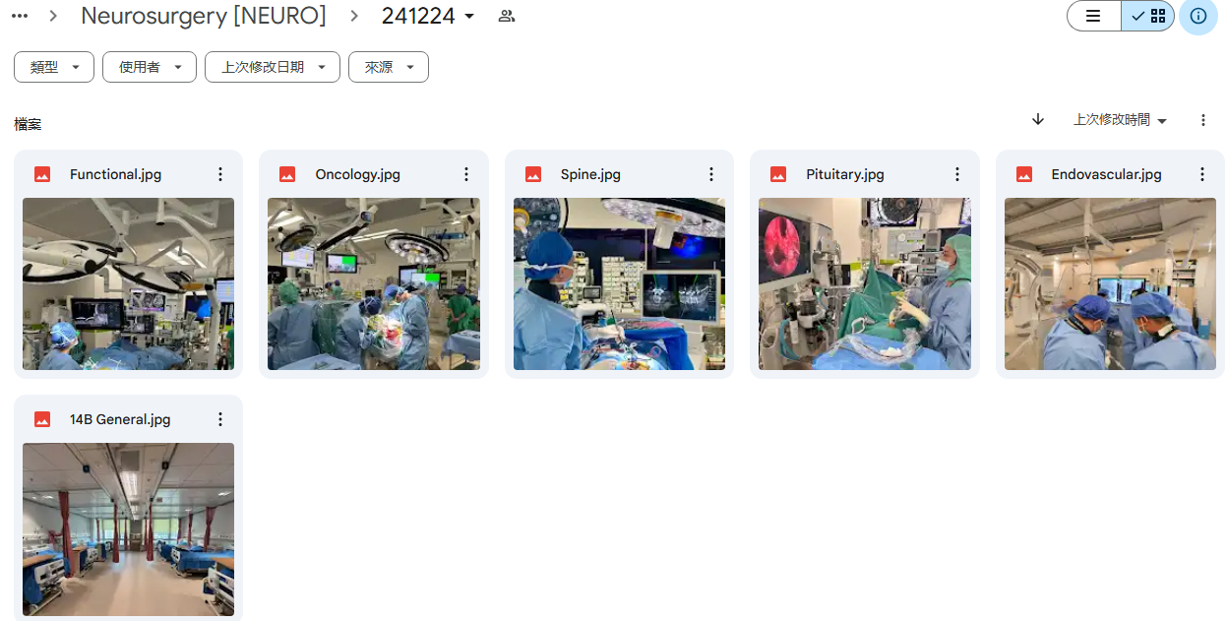
https://kwh.9u1.net/Services/Neurosurgery.html
from 23 Dec
由於圖片和文字段落對應不全, 請問可否改為上字下圖的格式?
https://drive.google.com/drive/u/2/folders/1VBZQb1iC5O0D1lBPWvWJLGSH_ljX1_o9
We would like to have the following photos amended. For the first photo in outpatient session and that of neurosurgical general ward under location, please change to attached jpg file 14B General
For the photo next to vascular / endovascular intervention -> jpg endovascular
Photo next to pituitary/ neuro-otology -> jpg pituitary
Photo next to oncology -> jpg oncology
Photo next to spine -> jpg spine
Photo next to functional neurosurgery -> functional
And is it possible to blur those bloody portion of the photos? especially for pituitary and oncology.

Slide 23
檢查部分
2025-01-08

Slide 24
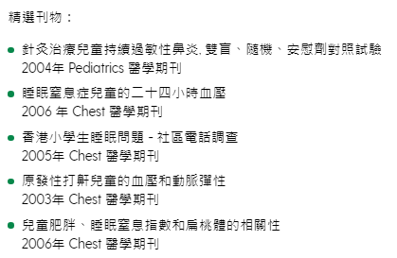
https://kwh.9u1.net/Services/Paediatrics-And-Adolescent-Medicine.html
from 16 Dec
已完成
中文版顯示方法為:

Slide 25
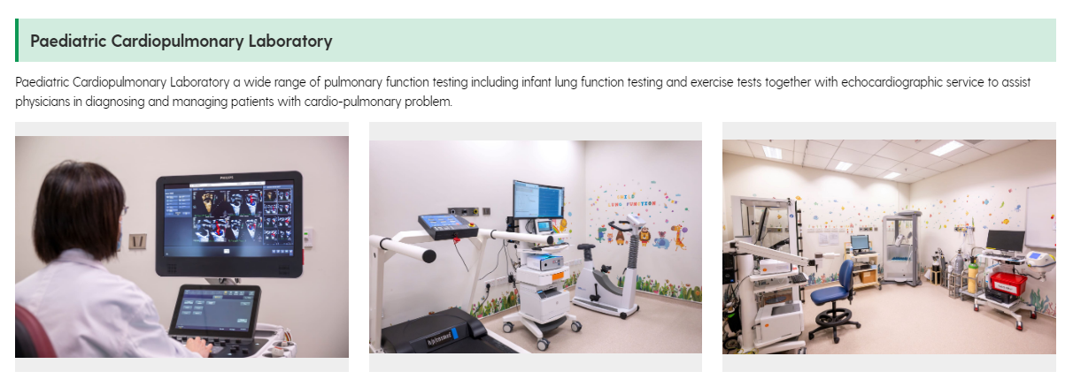
https://kwh.9u1.net/Services/Paediatrics-And-Adolescent-Medicine.html?lang=en
from 16 Dec
已完成
Paediatric Cardiopulmonary Laboratory offers a wide range of pulmonary function testing including infant lung function testing and exercise tests together with echocardiographic service to assist physicians in diagnosing and managing patients with cardio-pulmonary problem.

Slide 26
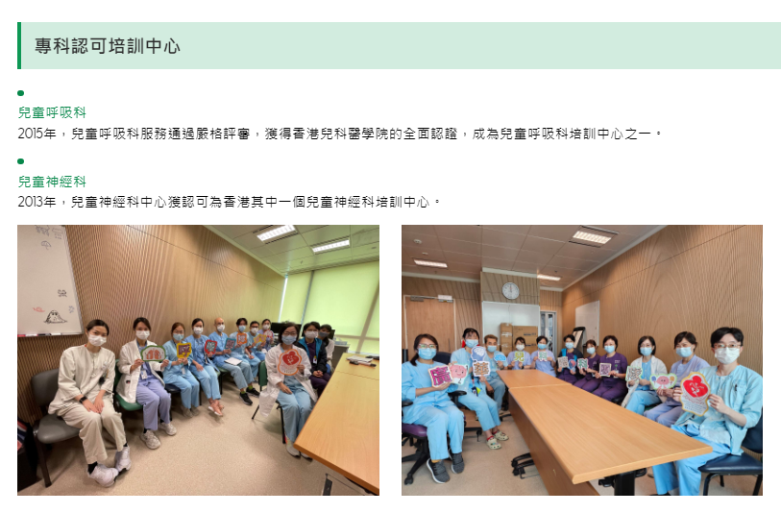
https://kwh.9u1.net/Services/Paediatrics-And-Adolescent-Medicine.html
from 16 Dec
已修改
綠點位置奇怪
所有語言

Slide 27
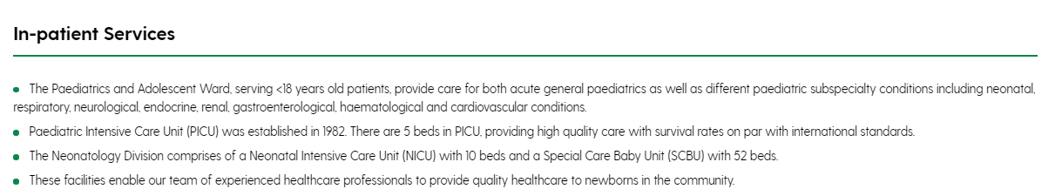
https://kwh.9u1.net/Services/Paediatrics-And-Adolescent-Medicine.html
from 16 Dec
已修改
The Paediatrics and Adolescent Ward, serving <18 years old patients, provide care for both acute general paediatrics as well as different paediatric subspecialty conditions including neonatal, respiratory, neurological, endocrine, renal, gastroenterological, haematological and cardiovascular conditions.
Paediatric Intensive Care Unit (PICU) was established in 1982. There are 5 beds in PICU, providing high quality care with survival rates on par with international standards.
The Neonatology Division comprises of a Neonatal Intensive Care Unit (NICU) with 10 beds and a Special Care Baby Unit (SCBU) with 52 beds.These facilities enable our team of experienced healthcare professionals to provide quality healthcare to newborns in the community.
移至上一行

Slide 28
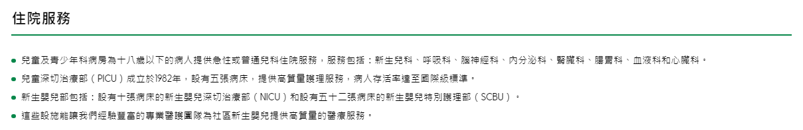
https://kwh.9u1.net/Services/Paediatrics-And-Adolescent-Medicine.html
from 16 Dec
已修改
兒科病房為十八歲以下的病人提供急性或普通兒科住院服務，服務包括：新生兒科、呼吸科、腦神經科、內分泌科、腎臟科、腸胃科、血液科和心臟科。
兒童深切治療部（PICU）成立於1982年，設有五張病床，提供高質量護理服務，病人存活率達至國際級標準。
新生嬰兒部包括：設有十張病床的新生嬰兒深切治療部（NICU）和設有五十二張病床的新生嬰兒特別護理部（SCBU）。這些設施能讓我們經驗豐富的專業醫護團隊為社區新生嬰兒提供高質量的醫療服務。
移至上一行

Slide 29
https://kwh.9u1.net/Services/Speech-Therapy.html
from 16 Dec
已修改
刪除Service Introduction的所有相片

Slide 30
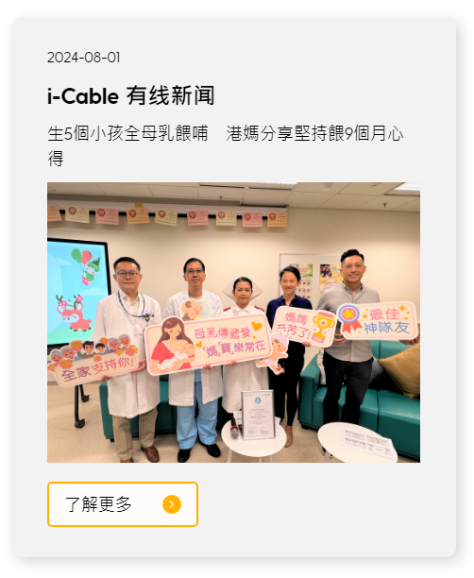
https://kwh.9u1.net/Media-Reports.html
from 17 Dec
已修改
簡體中文版還是顯示繁體內容
生5个小孩全母乳喂哺 港妈分享坚持喂9个月心得

Slide 31

https://kwh.9u1.net/Services/Orthopaedics-And-Traumatology.html?lang=en
from 17 Dec
已修改
should be “8:00AM – 8:00PM”

Slide 32
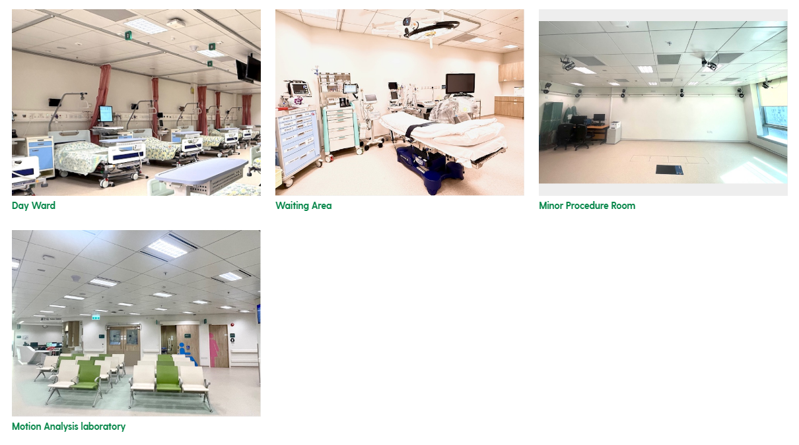
https://kwh.9u1.net/Services/Orthopaedics-And-Traumatology.html
from 17 Dec
已修改
圖片錯誤，請根據https://docs.google.com/presentation/d/1odKtd0YtUGW6ENRgx2GAGoJ-xo_FsqzO/edit#slide=id.p7 整理

Slide 33
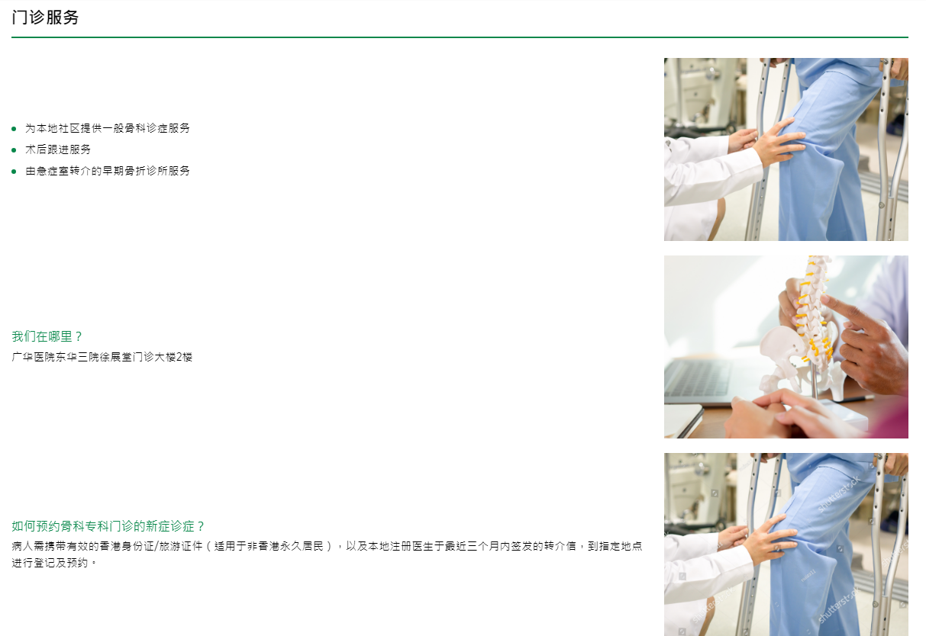

https://kwh.9u1.net/Services/Orthopaedics-And-Traumatology.html
from 17 Dec
已修改
圖片錯誤
請更換

Slide 34
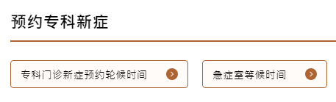
https://kwh.9u1.net/Specialist-Out-patient.html
from 23 Dec
已修改
急症室等候时间
連結錯誤
更改為https://www.ha.org.hk/visitor/ha_visitor_index.asp?Content_ID=235504&Lang=CHIB5

Slide 35
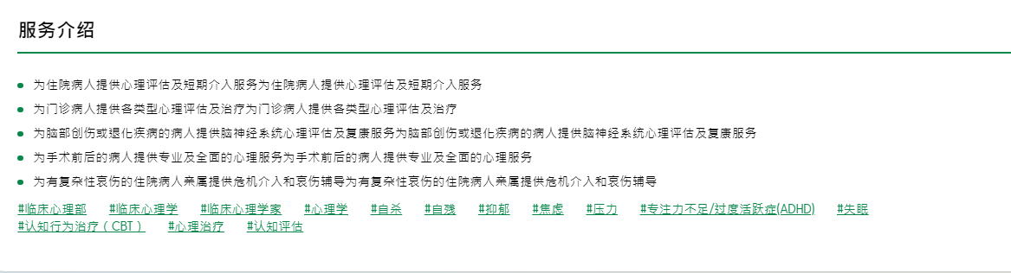
https://kwh.9u1.net/Services/Clinical-Psychology.html?lang=zh-cn
from 23 Dec
不明白
簡體中文版本內容重複

Slide 36

https://kwh.9u1.net/Visitors.html
from 24 Dec
已修改
要同時顯示
「捐款」
和
「義工」
捐款連結:https://www.tungwah.org.hk/fund-raising/fr-introduction/ (請連結不同語言)
義工連結:https://kwh.9u1.net/Services/Health-Promotion-Centre.html

Slide 37
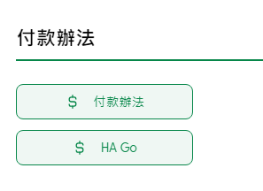
https://kwh.9u1.net/Services/Shroff-Office.html?lang=hk
from 27 Dec
請提供連結
付款辦法連結失敗

Slide 38
2025-01-06

Slide 39
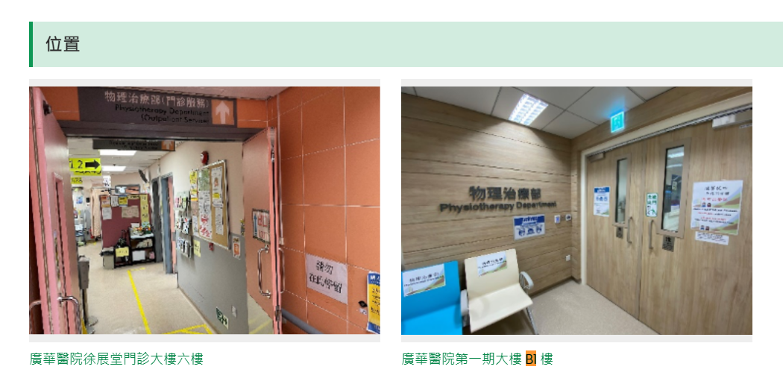
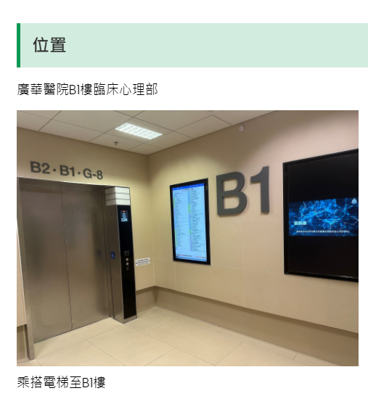
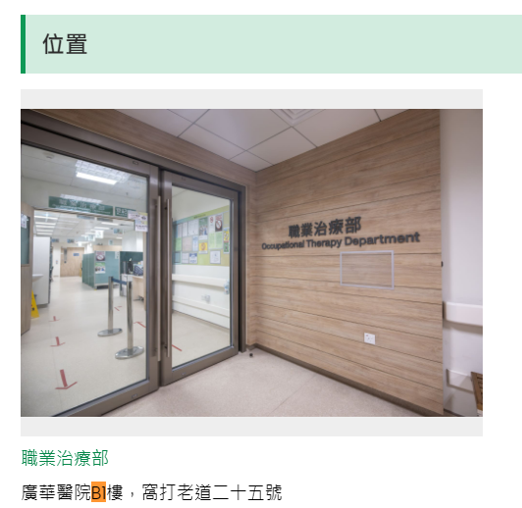
所有中文版面
https://kwh.9u1.net/Services/Physiotherapy.html
已修改
B1/F 更改為 「地庫一層」
地库一层
https://kwh.9u1.net/Services/Clinical-Psychology.html
https://kwh.9u1.net/Services/Occupational-Therapy.html

Slide 40
https://kwh.9u1.net/Services/Pharmacy.html
已修改
新增標籤
#藥房 #藥劑部 #取藥 #配藥 #藥物諮詢

Slide 41
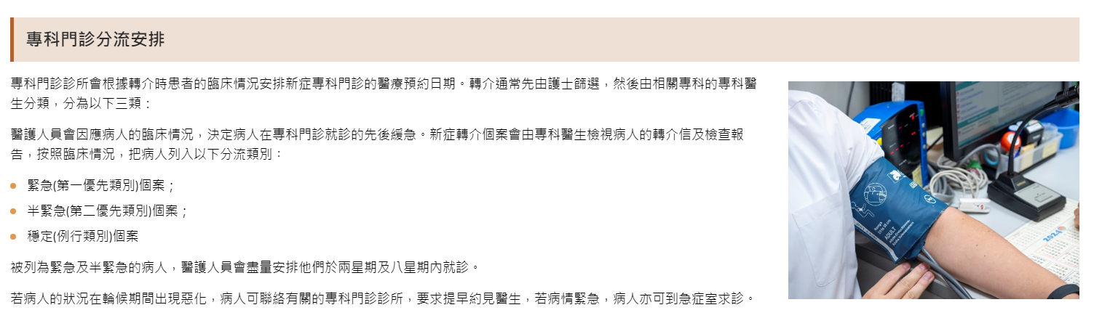
https://kwh.9u1.net/Specialist-Out-patient.html
已修改
如果情況為急性，患者亦可前往急症室尋求即時治療，診所將根據需要為患者作出安排。

Slide 42

https://kwh.9u1.net/Services/Clinical-Psychology.html
已修改
購買此水印圖並更改封面圖片

Slide 43
2025-01-08

Slide 44
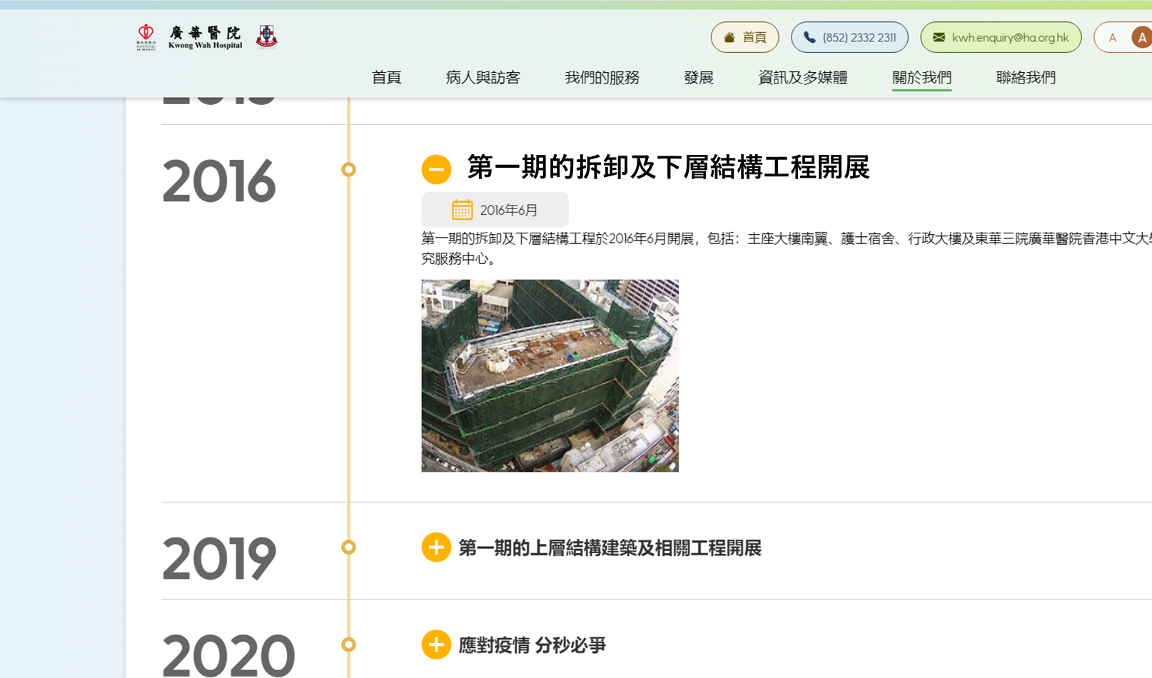
https://kwh.9u1.net/history.html?lang=hk
已修改
「在2016年」更改為「第一期的拆卸及下層結構工程開展」

Slide 45
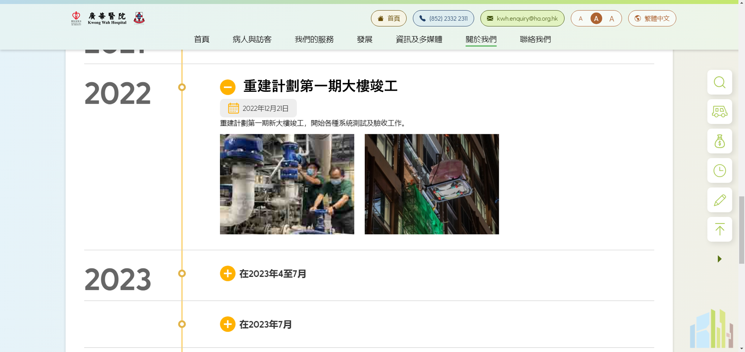
https://kwh.9u1.net/history.html?lang=hk
已修改
「在2022年」更改為「重建計劃第一期大樓竣工」

Slide 46
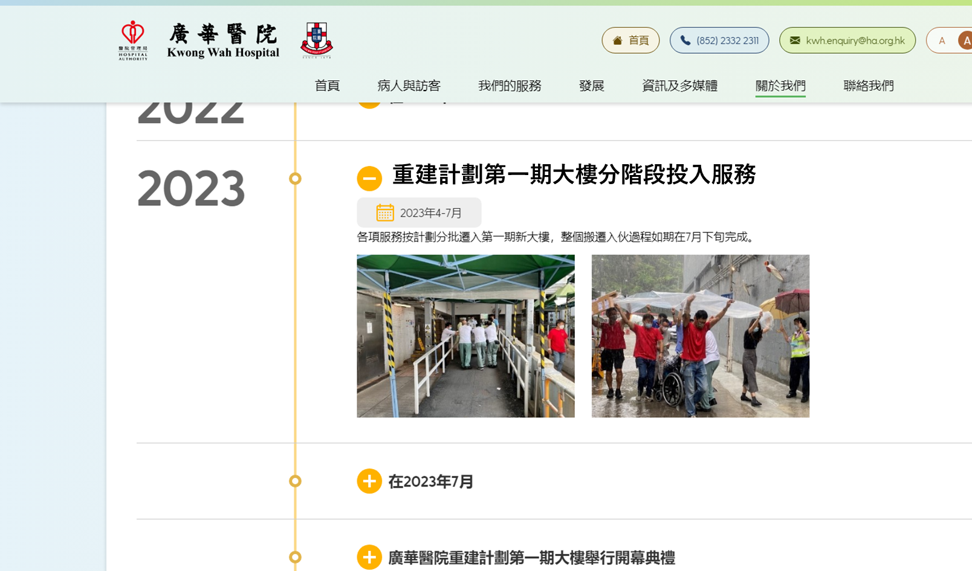
https://kwh.9u1.net/history.html?lang=hk
已修改
「在2023年4至7月」更改為「重建計劃第一期大樓分階段投入服務」

Slide 47
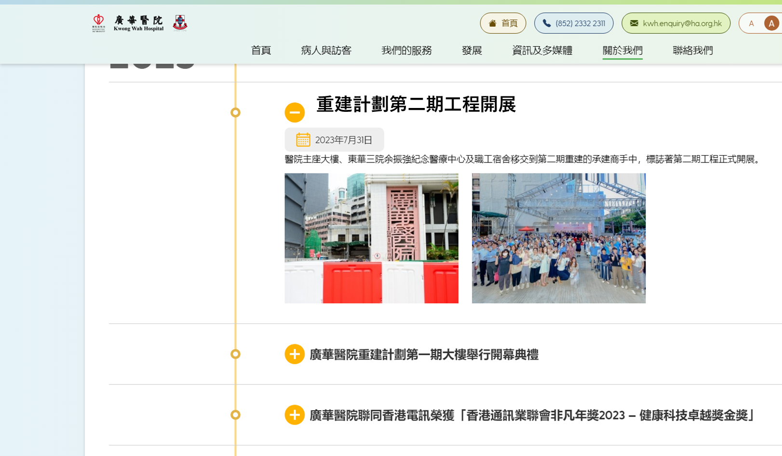
https://kwh.9u1.net/history.html?lang=hk
已修改
「在2023年7月」更改為「重建計劃第二期工程開展
」

Slide 48
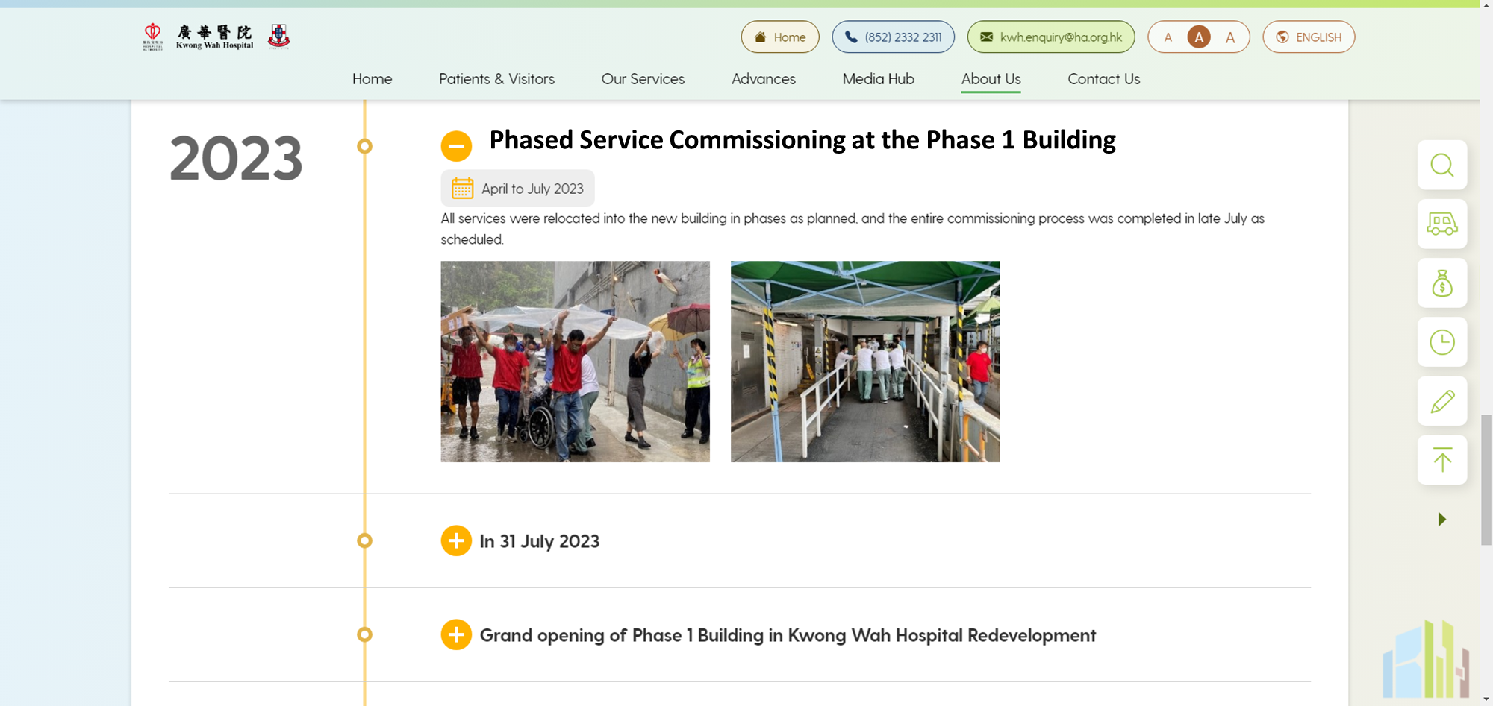
https://kwh.9u1.net/history.html?lang=en
已修改
與PPT第3頁起衝突, 以此一稿作準
「In April-July 2023」更改為「Phased Service Commissioning at the Phase 1 Building」

Slide 49
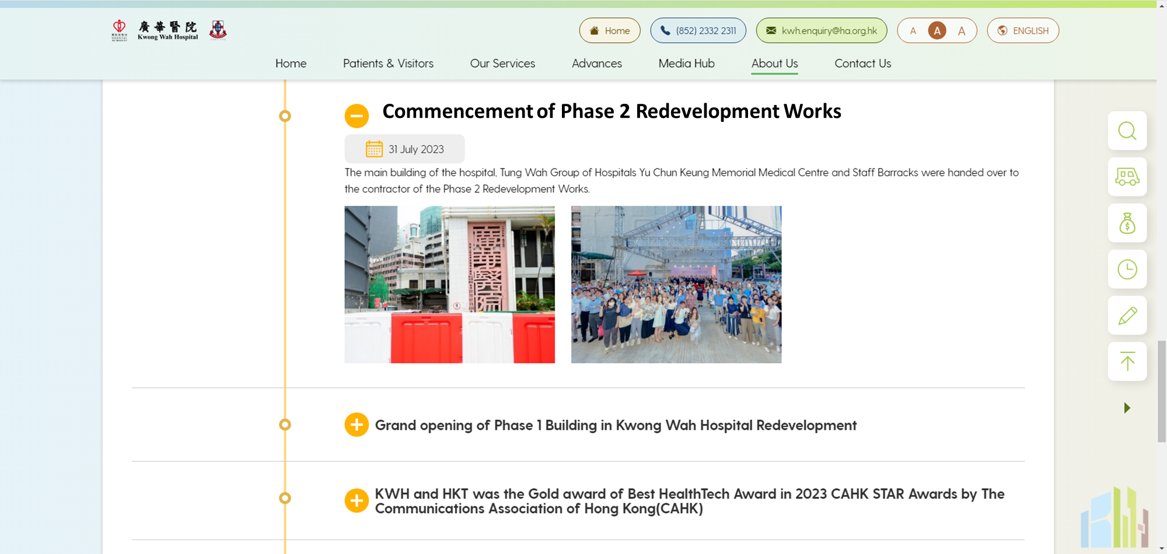
https://kwh.9u1.net/history.html?lang=en
已修改
與PPT第3頁起衝突, 以此一稿作準
「In 31 July 2023」更改為「Commencement of Phase 2 Redevelopment Works」

Slide 50
https://kwh.9u1.net/Mission.html
已修改
更換高清圖片
https://drive.google.com/drive/folders/1mhS7xg0ztca2LRSTHeD0_lBmmhofXFve?usp=drive_link

Slide 51
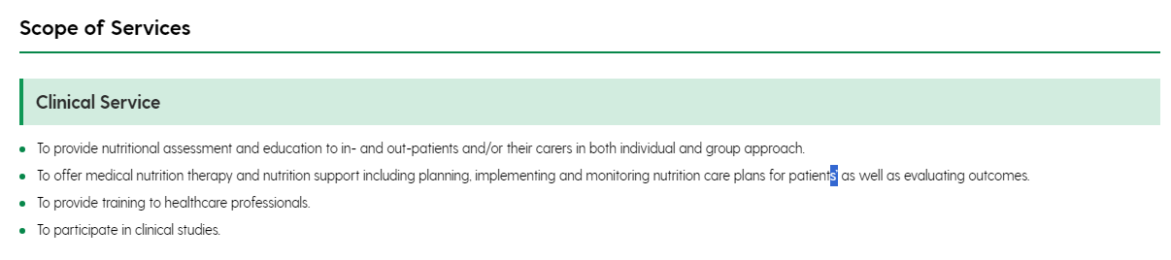
https://kwh.9u1.net/Services/Dietetics.html
已修改
刪除「’」
To offer medical nutrition therapy and nutrition support including planning, implementing and monitoring nutrition care plans for patients as well as evaluating outcomes.
更改封面圖片為https://drive.google.com/file/d/1v8YVfepZbxcF8mvaMFRxpaBd2x7wWNCJ/view?usp=drive_link

